Slide 1

Glowing Day Project VISIT TUNISIA
A virtual Tourist Guide

Slide 2
TABLE OF CONTENTS
01
02
03
INTRODUCTION
Consept & elements
What is Visit Tunisia
What is it build of?
Code & Dev
JS fonction and CSS highlights

Slide 3
Web app?
The following project is a multi purpose responsive web app and an online blog in the tourism field

Slide 4
01
INTRODUCTION
Visit Tunisia, for your future visits to the country

Slide 5

Visit Tunisia is a multi purpose vurtual tourist guide and it is perfect for newcomers and locals to explore Tunisia
— A tourism Web app —

Slide 6
What does Visist Tunisia consist of
Visual content
Code overview
A splendid collection of tunisian landscpae as well as a versatile video and fun facts about Tunisia
An index page, a stylesheet and 3 Js files : Weather js , index js and slider js

Slide 7
02
Concept & Elements
What can you find in visit Tunisia web app?

Slide 8
Brainstorming & concept
Pre-exisiting?
Image & Represenatation
1
2
Yes, but the design and the UI/UX is mid
Showcase Tunisia in a very sophisticated appealing way
Horizons
Training
4
3
What is to be improved later on , back –end, Databases & active Blog
Try to integrate the majority of what I learned in level I Web Dev withing Opus Lab

Slide 9
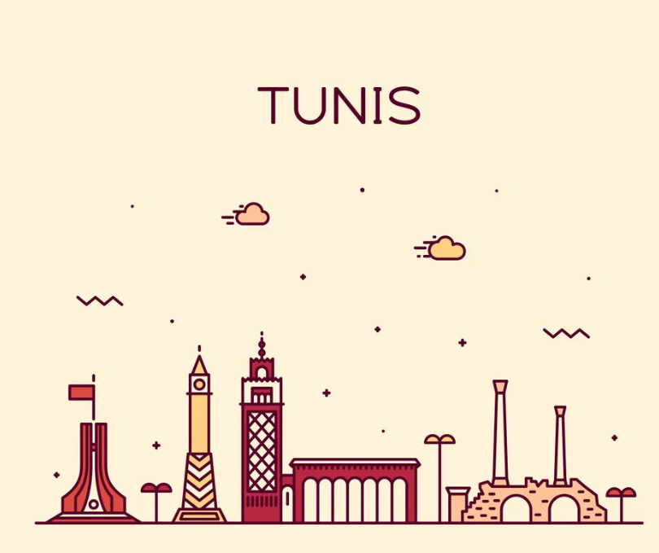
Intro, Galleries, Sliders and trends
Elements
In total there are 3 sliders existing in the banner, in the trend section and in the cultural appreciation gallery

Slide 10
More elements
Newsletter
GeoLocation
Forecast
A simple form filling subscription to keep the user updated on the trends
A fully functionning app in order to find desired toristic and historic locations
A weather pill that display current weather and forcast of the week

Slide 11
FAQ Section
Some of the most communly asked question

Slide 12
03
Code & Web Dev
Stages and special tricks

Slide 13
The coding Process
HTML
JS Vanilla
CSS
@media
The web ap skeleton
Activate CSS changes,sliders and weather infos
Colors, animations and hover effect
Make the app responsive on different monitor display dimensions

Slide 14
CSS Usage
Layout
Animations
Hidden & Hover
Venus is the second planet from the Sun
Despite being red, Mars is a cold place
Saturn is a gas giant and has several rings

Slide 15
JS Files
Weather.js
Slider.js
Get time date and expand/reduce the weather pill (activate CSS)
Controles movement of pics , slider animation and button behaviour
Index.js
CSS VAR
Pre-loader,Video player set up, movement activation when first scrolled as well as FAQ section apperence
Usage of colors variables to be called later on

Slide 16
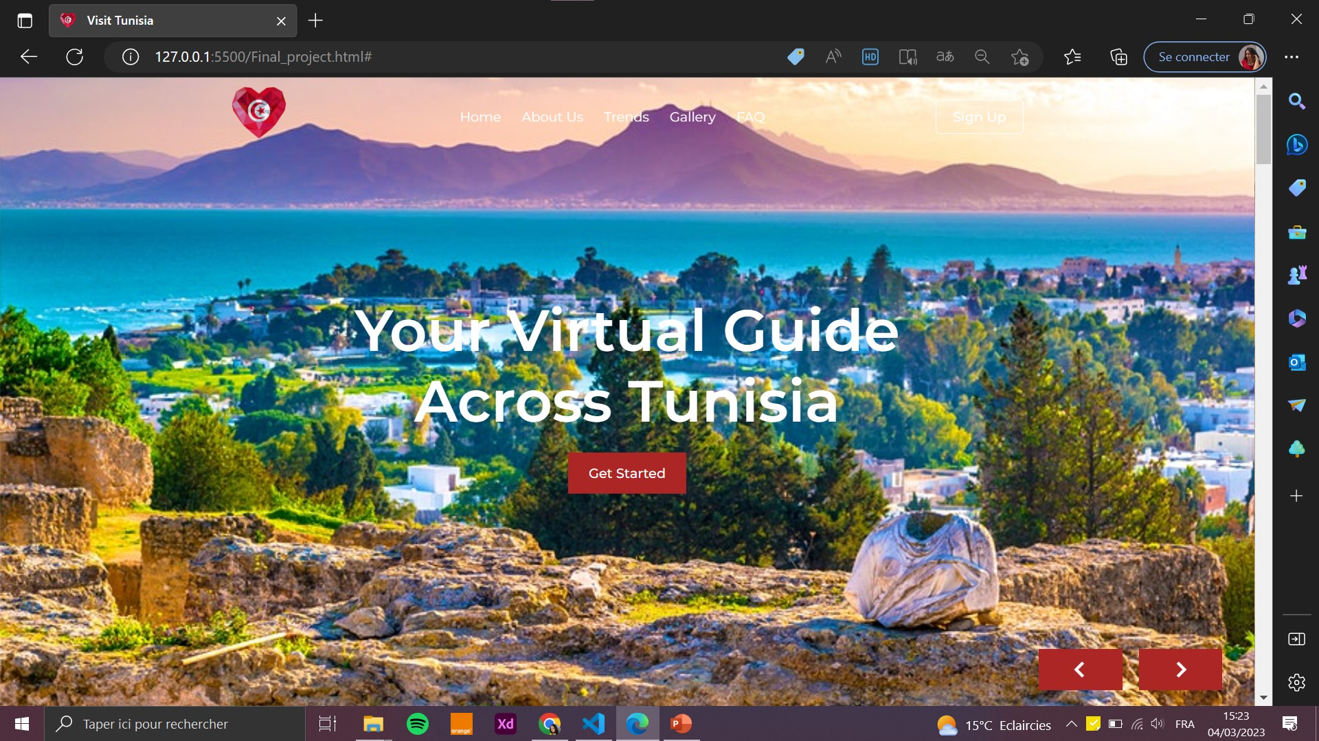
Responsive DESKTOP Version
Most of the elements are redone with CSS @media param adjustement in order to go from this view

Slide 17
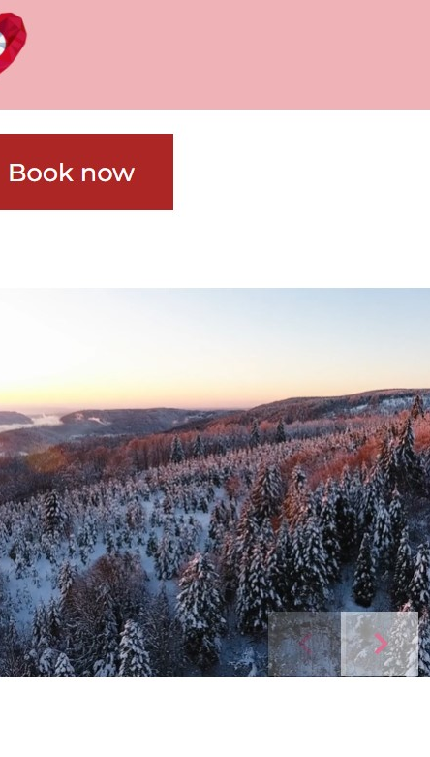
Responsive MOBILE WEB version
To this view : screen display settings

Slide 18
THANKS!
Do you have any questions?
Sarah.hania15@gmail.com
+216 20 933 908
Visitunisia.com
Thank u for such a wonderful training journey

